Slide 1
Optimal number of threads
Jesus Orlando Rodriguez Ramirez A01731627
Carlos Ignacio Villalobos Sanchez A01731558

Slide 2
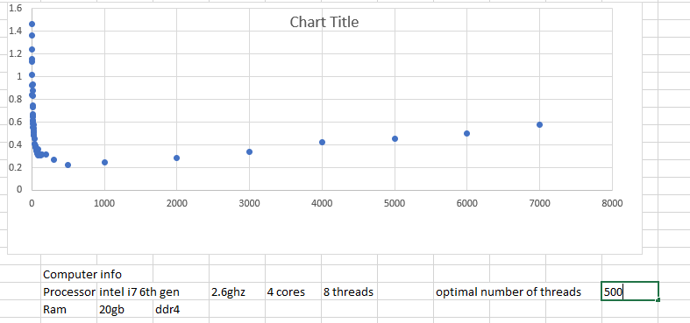
Alienware 15r2

Slide 3
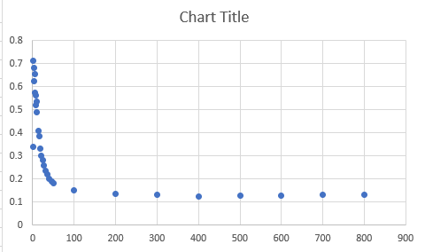
Thunderbolt 911 plus

